Slide 1
Facial Recognition Attendance Management System
Presented By:-
Isha Kumari (1VE21CA016)
Riddhi Kapil (1VE21CA038)
Shaishta Anjum (1VE21CA045)
Siddhi Kapil (1VE21CA046)

Slide 2
Abstract
Project Overview: The Face Recognition Based Attendance System is a comprehensive solution for automating attendance management through facial biometrics.
Core Functionality: It utilizes machine learning algorithms to analyze and identify facial features, enabling accurate recognition of registered users for attendance purposes.
Implementation Scope: This project addresses the need for efficient attendance tracking in dynamic environments, ensuring data integrity and user privacy.
Key Features: Highlights include real-time attendance logging, user-friendly interface design, and robust security measures to protect sensitive data.
Expected Outcomes: By replacing manual attendance methods, the system aims to streamline operations, reduce errors, and provide actionable attendance insights for administrators.

Slide 3
Problem Statement
The project aims to replace traditional attendance methods with a more efficient and reliable system using facial recognition technology. Traditional methods such as manual entry or card-based systems are prone to errors, time-consuming, and susceptible to fraudulent practices like buddy punching.
By implementing facial recognition, the project seeks to automate attendance tracking by accurately identifying individuals based on their unique facial features. This system will not only improve accuracy and reliability but also reduce administrative overhead, providing a seamless and secure way to manage attendance for educational institutions or organizations.

Slide 4
Objective
Implement a user-friendly interface for ease of use by administrators and users.
Develop a robust face detection and recognition mechanism using OpenCV and machine learning models.
Implement a real-time attendance tracking system capable of handling varying lighting conditions and facial expressions.
Ensure accurate identification and recording of attendance data for each recognized individual.
Create a user-friendly interface for administrators to manage user registrations and attendance records effectively.
Optimize the system for high performance and reliability under different environmental conditions.

Slide 5
Modules
User Interface
Face Detection
Recognition & Verification
Attendance Logging

Slide 6
User Interface
Incorporates responsive design principles to ensure usability across various screen sizes and devices.
Implements secure authentication mechanisms, such as password hashing and session management, to protect user data.
Enables administrators to generate attendance reports, export data in different formats (e.g., CSV), and manage system settings.
Supports multilingual capabilities to accommodate users from diverse linguistic backgrounds.
Integrates error handling and feedback mechanisms to guide users through the attendance recording process effectively.

Slide 7
Face Detection Module
Optimizes face detection parameters (e.g., scale factor, minimum neighbors) for different lighting conditions and environments.
Implements real-time face detection capabilities to capture attendance quickly and efficiently.
Includes mechanisms for handling occlusions and partial face views to improve overall detection accuracy.
Utilizes parallel processing techniques to enhance performance when processing multiple video streams simultaneously.
Integrates logging and debugging functionalities to monitor and improve face detection performance over time.

Slide 8
Recognition and Verification Module
Develops a robust facial recognition pipeline, including feature extraction and comparison techniques, to identify individuals accurately.
Implements algorithms to handle variations in facial expressions, head poses, and aging effects for reliable recognition.
Integrates machine learning models trained on large datasets to improve recognition accuracy over time.
Incorporates quality assessment metrics to evaluate the reliability of recognition results and minimize false positives.
Provides a feedback mechanism for users to correct attendance records in case of misidentification or errors.

Slide 9
Attendance Logging
Logs attendance in real-time upon recognition.
Includes timestamps for each attendance entry.
Ensures data integrity and security.
Maintains detailed audit trails of attendance activities.
Integrates smoothly with reporting modules for generating attendance reports.

Slide 10
Proposed Methodology
Secure login and user profile management using Flask.
Face detection using Haarcascade algorithm with OpenCV.
Face recognition using Scikit-Learn and NumPy.
Model storage and retrieval using Joblib.
Automatic attendance logging with timestamps.
Storing attendance data in CSV files.
Integration with existing systems for data synchronization.
Deployment on local server.
Thorough testing under various conditions.

Slide 11
Hardware Implementation
Camera: Utilizes a high-resolution webcam for capturing real-time facial images.
Computer System: A computer or server to run the Flask application and handle image processing.
Storage Device: Sufficient storage capacity for saving user images and attendance logs.
Network Infrastructure: Reliable network connectivity for communication between the client interface and the server.
Display Monitor: A monitor for displaying the user interface and attendance logs.

Slide 12
Snapshot

Slide 13
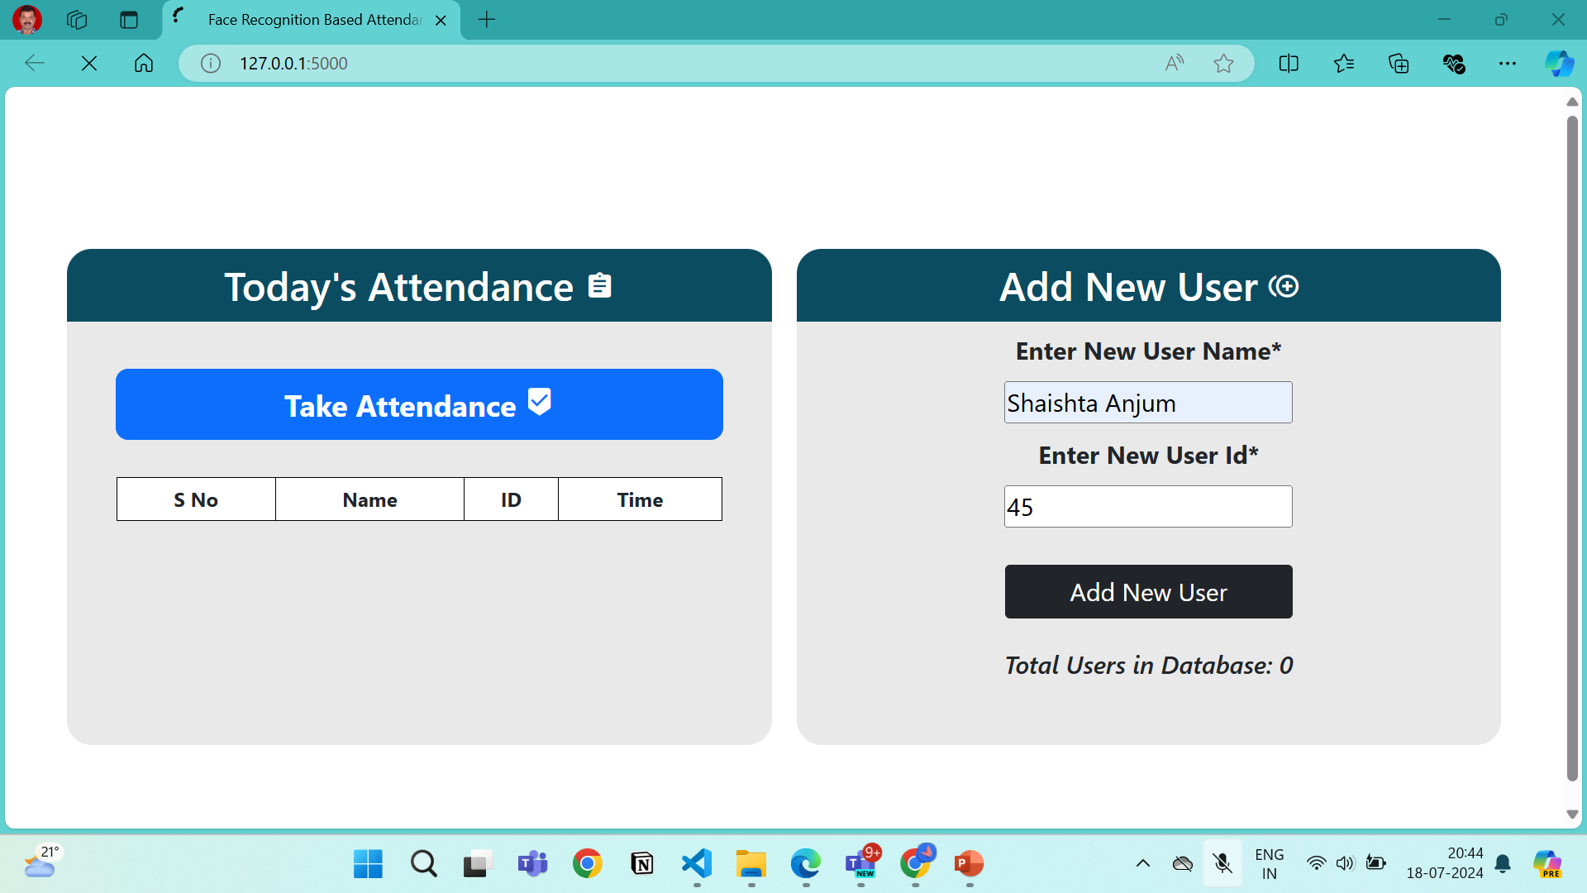

Slide 14
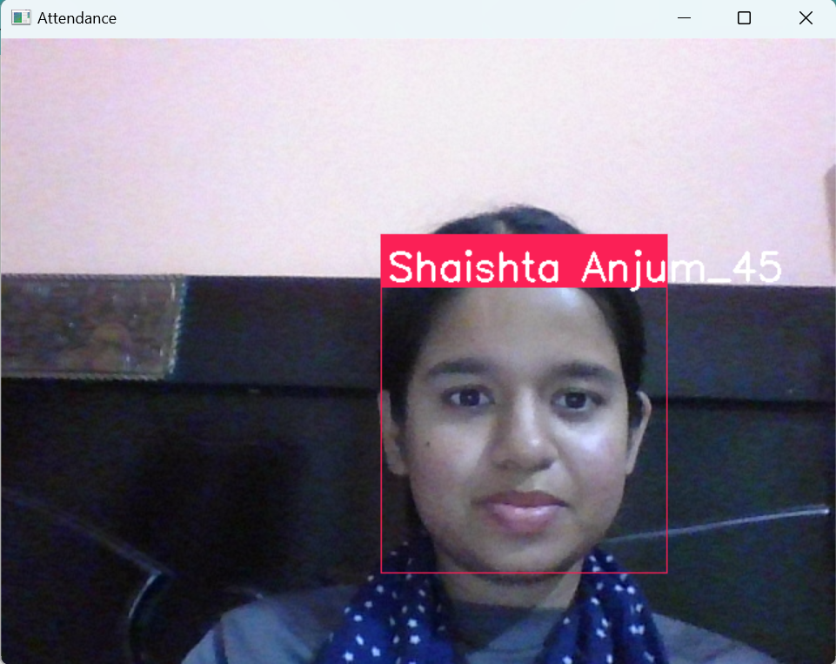

Slide 15
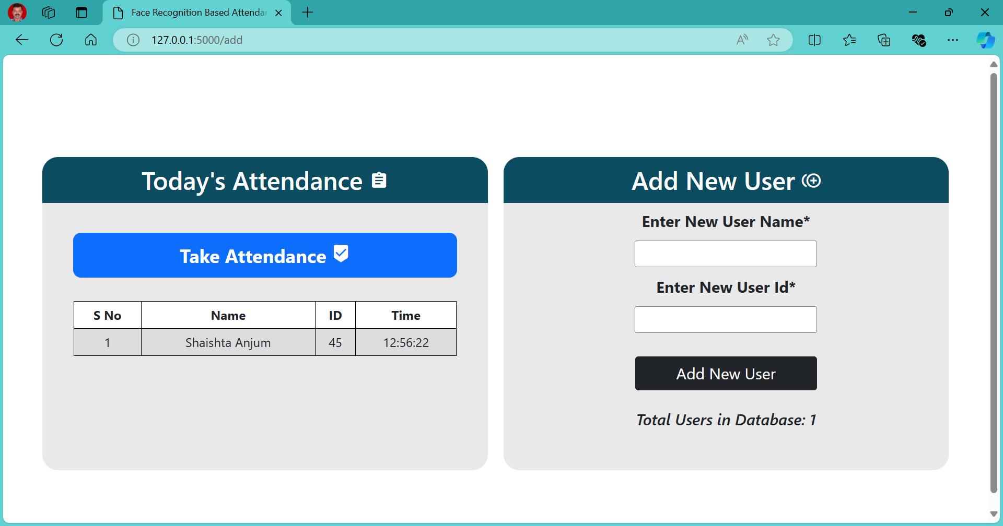

Slide 16
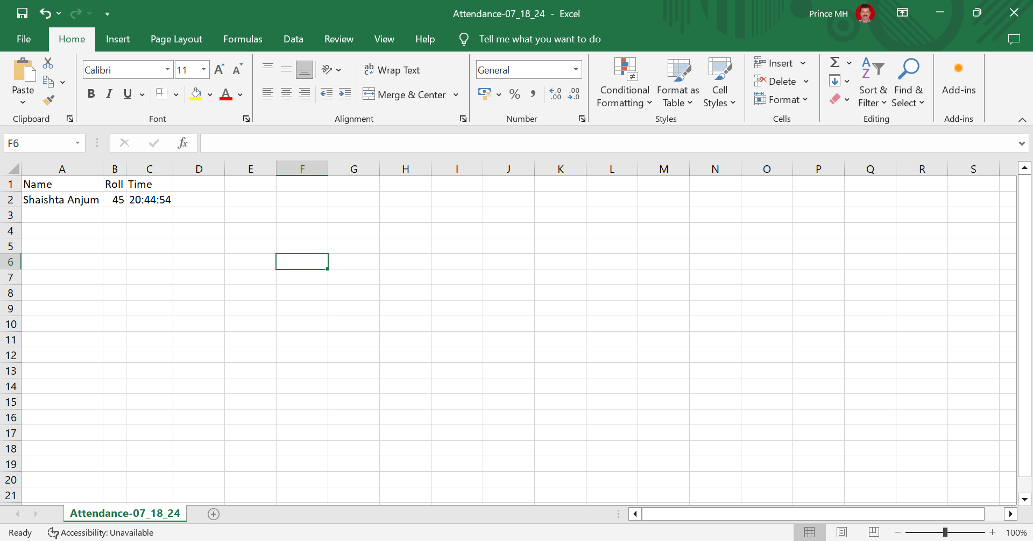

Slide 17
Conclusion
The Face Recognition-Based Attendance System provides an accurate and efficient solution for tracking attendance, significantly reducing the manual effort and errors associated with traditional methods. With its user-friendly interface, the system ensures ease of use, allowing users to effortlessly navigate and manage attendance records. Utilizing advanced machine learning algorithms and robust facial recognition techniques, the system offers high reliability and security. Furthermore, its scalable design enables the system to accommodate an increasing number of users, making it suitable for various organizations. Overall, this system represents a significant advancement in attendance management, combining technology with convenience and accuracy.

